Slide 1
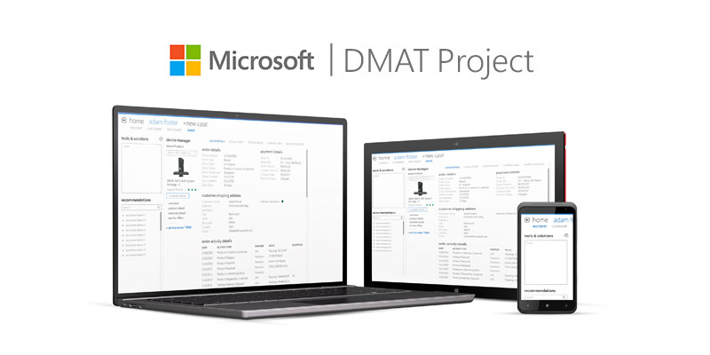
DMAT Project
The Challenge
Microsoft came to Affirma when they needed a custom, web-based solution to support the launch of Windows 8. The solution was for customer support agents at Microsoft to support the Surface Tablet product launch.
What We Did
For this launch we had to rethink the way that agents would interact with consumers on their devices. We studied the use cases, built the user-flows, observed customer support agents in their natural habitat, and created the designs.
Results
Microsoft estimated that the build process would take three months. Thanks to our team's unrelenting efforts DMAT, we were able to deliver a comprehensive solution in half the time.

